Slide 1

Airbnb Listing and Rentals Data Analysis
By: Arjun Dasharathi, Alessandra Araujo, Nadia Iskandar, Nazanin Azari

Slide 2

Project Data Scope:
To study the data set from Airbnb listings and rentals to predict the pricing ay, we can extract which are the neighbourhoods with the largest amount of offers.
Since 2008, guests and hosts have used Airbnb to expand on traveling possibilities and present more unique, personalized way of experiencing the world. This dataset describes the listing activity and metrics in NYC, NY for 2019.
This data file includes all needed information to find out more about hosts, geographical availability, necessary metrics to make predictions and draw conclusions.

Slide 3

Data Set:
Airbnb listing activity and metrics in NYC, NY for 2019.
This data file includes all needed information to find out more about hosts, geographical availability, necessary metrics to make predictions and draw conclusions

Slide 4
Data Source
This public dataset is part of Airbnb, and the original source can be found on this website.
"AB_NYC_2019" - Summary information and metrics for listings in New York City. It is good for exploration, visualizations and predictions.

Slide 5
Description of Columns
id: listing ID
name: name of the listing
host_id: host ID
host_name: name of the host
neighbourhood_group: location
neighbourhood: area
latitude: latitude coordinates
longitude: longitude coordinates
room_type: listing space type
price: price in dollars
minimum_nights: amount of nights minimum
number_of_reviews: number of reviews
last_review: latest review
reviews_per_month: number of reviews per month
calculated_host_listings_count: amount of listing per host
availability_365: number of days when listing is available for booking

Slide 6
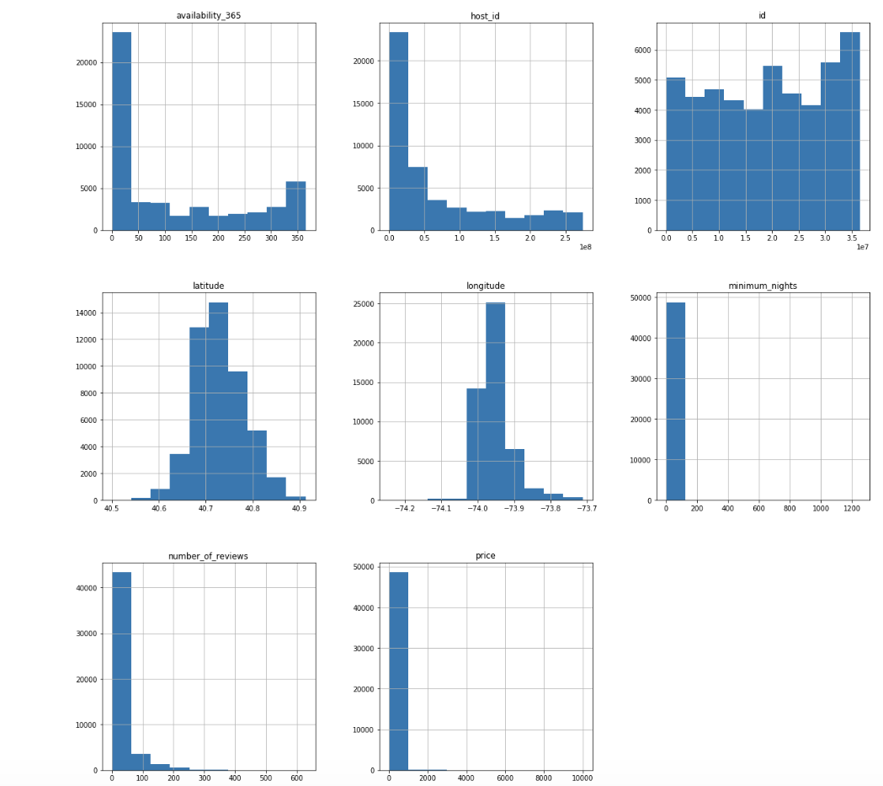
Histogram of Numerical Value Columns

Slide 7
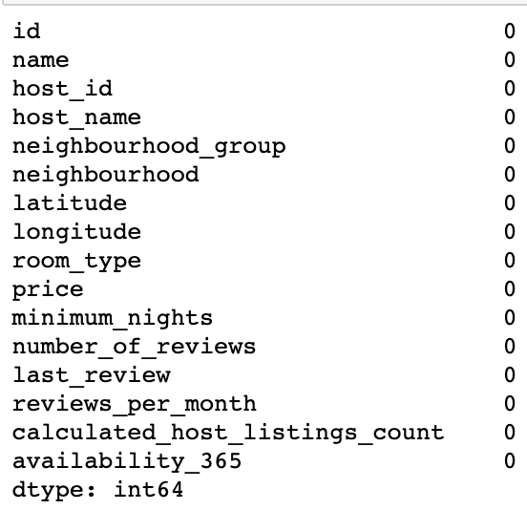
Data Exploration & Clean-up Process
Fill empty data in host name column

Slide 8
Data Exploration & Clean-up Process
Cleaning data by selecting only with more than 0 availability
Saved data with availability bigger than 0 to the CSV file
Calculating the number of data before and after cleaning
Sample data contains 48895 rows However the number of clean data is only 31362 , which is 64.14% of whole sample

Slide 9
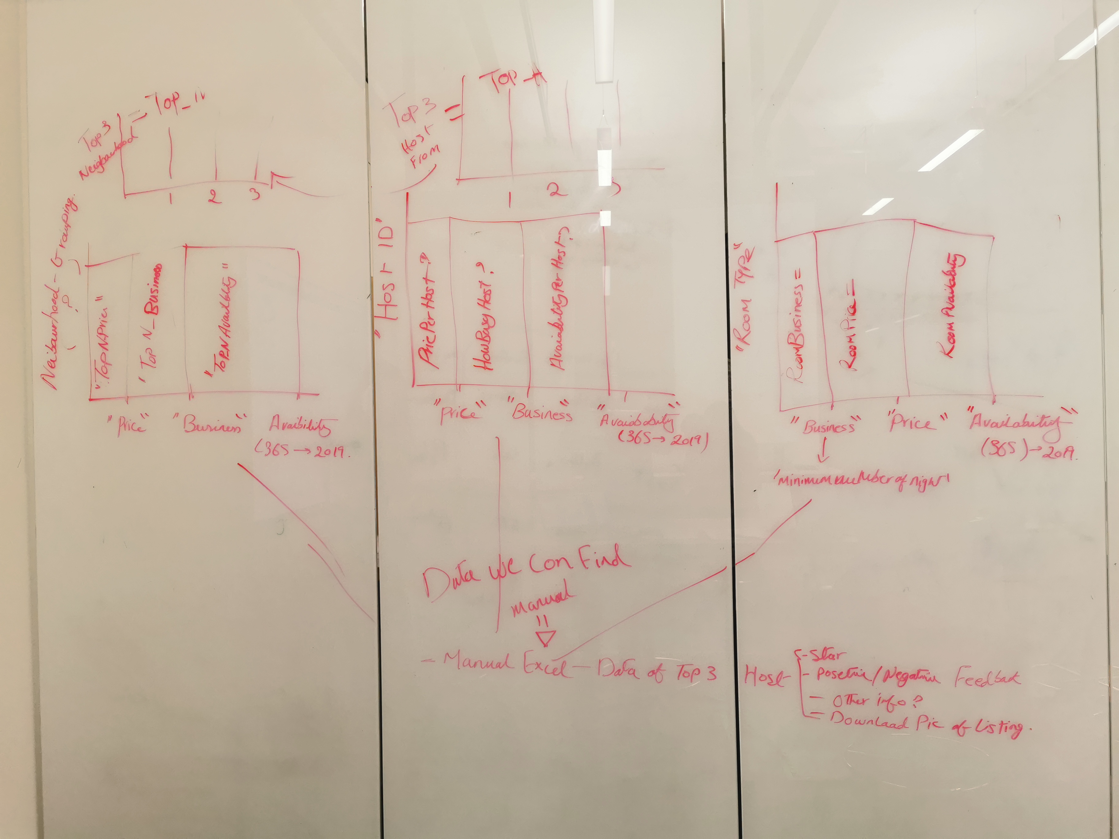

Brainstorming

Slide 10
Data Exploration & Clean-up Process
Made Functions for multiple uses
Function to add title, xlabel and ylabel in just one line
Made a function for adding text in bar graph

Slide 11
The main questions:
Which is the neighbourhood-group that has the max number of listings?
What is the average price per listing in a neighborhood, regardless of the room type?
What is the distribution of average of price based on room types?
What is the average price per room type based on a neighbourhood-group?
What is the density of listings in each neighbourhood-group?
What is the number of listings in each neighbourhood-group? (the top 5)

Slide 12
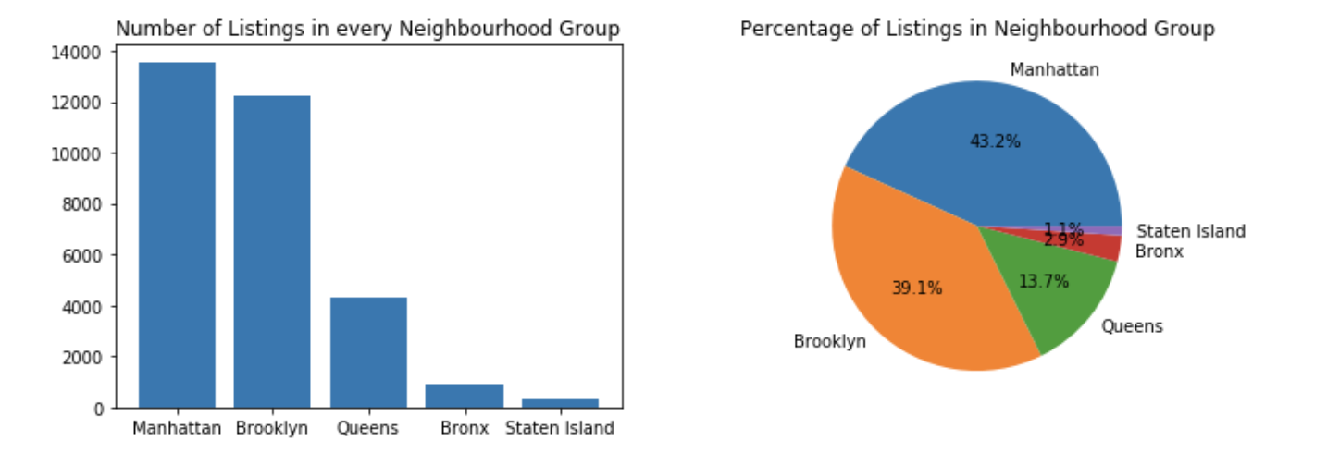
neighbourhood-groups
Manhattan is the neighbourhood with the highest number of listings out of all the neighbourhood-groups
Manhattan is also the most expensive by the listing price among all the neighbourhood-groups

Slide 13
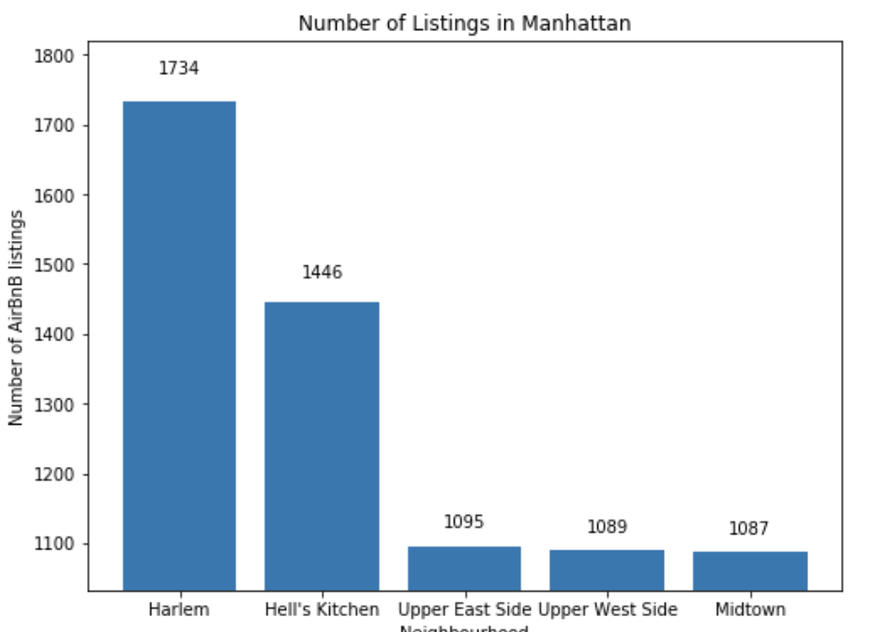
neighbourhood-groups
As a deep dive we have observed the listings distribution within Manhattan and found Harlem has the highest number of listings whereas Tribeca has the highest price.

Slide 14
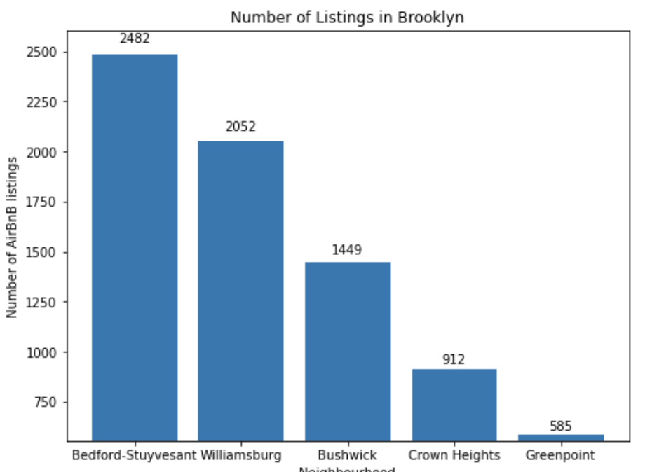
neighbourhood-groups
Other Neighbourhoods:

Slide 15
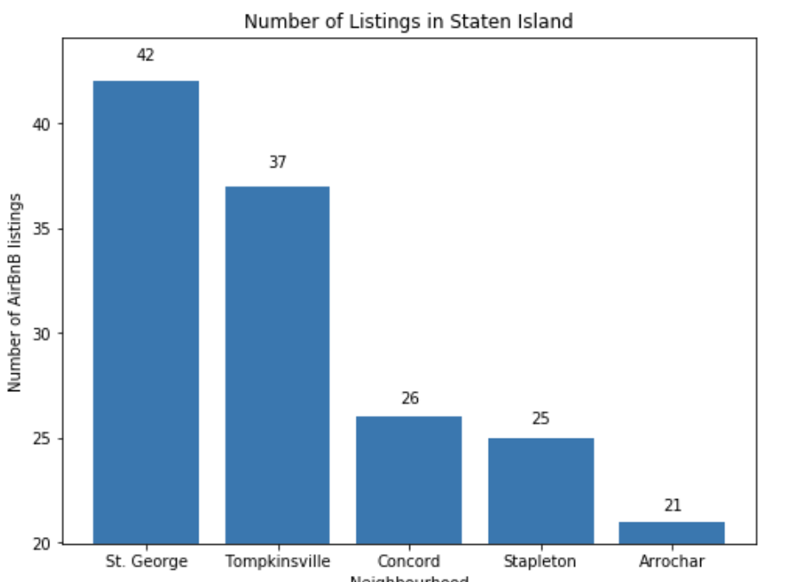
neighbourhood-groups
Other Neighbourhoods:

Slide 16
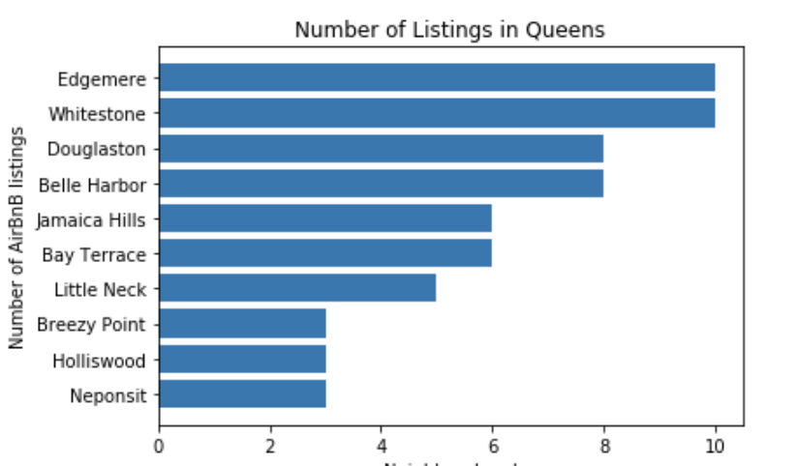
neighbourhood-groups
Other Neighbourhoods:

Slide 17
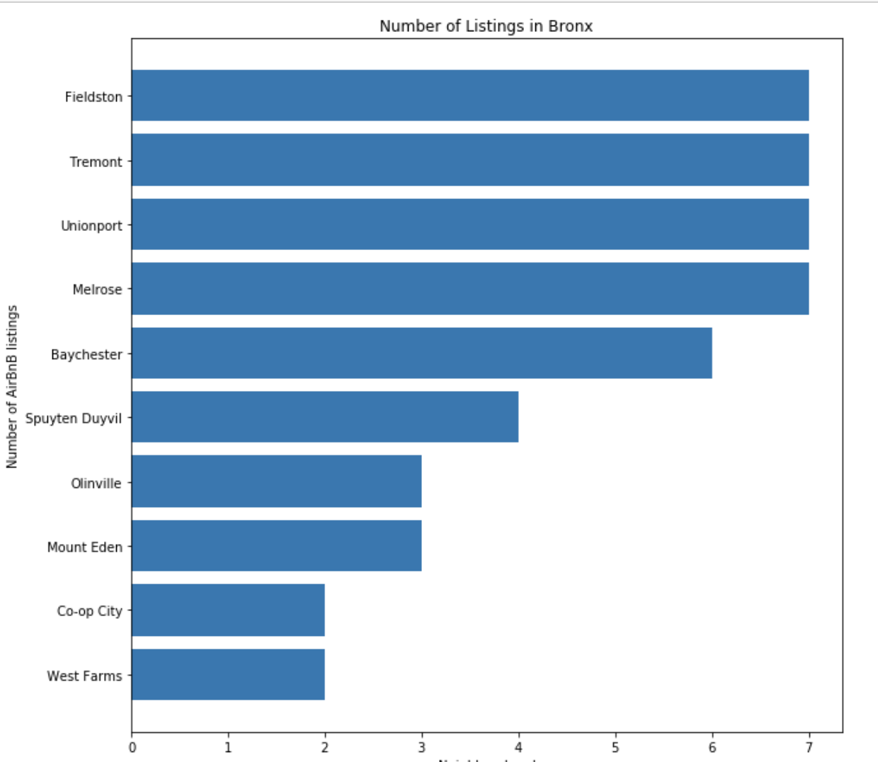
neighbourhood-groups
Other Neighbourhoods:

Slide 18
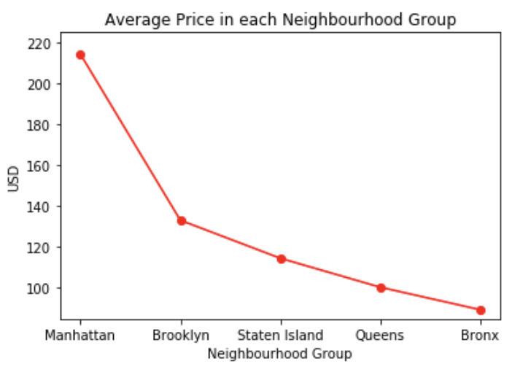
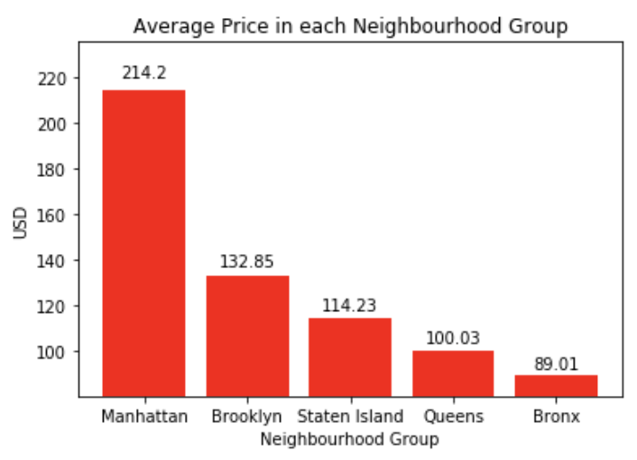
Average price in each neighbourhood
Other Neighbourhoods:

Slide 19
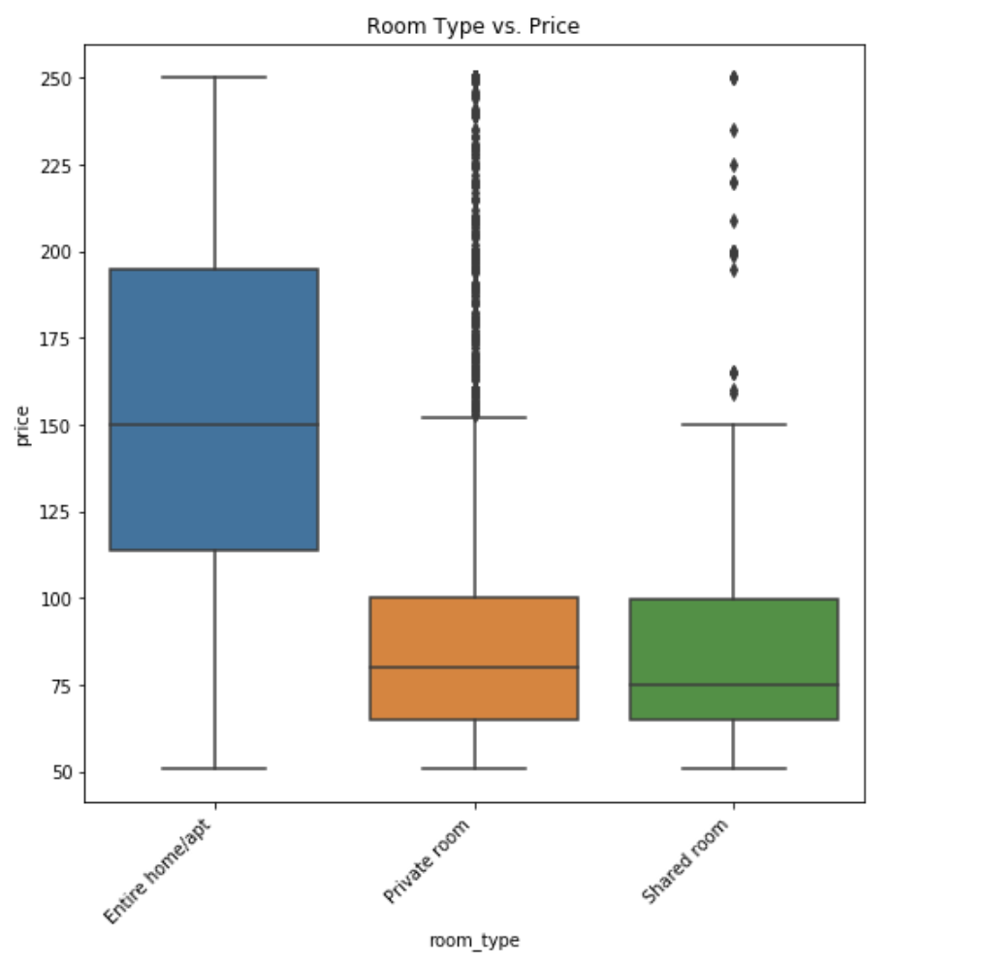
Analysis by Room Type
Overall renting an entire home/ apartment is more expensive.
However, renting a private or shared room is cheaper/ similar in comparison.

Slide 20
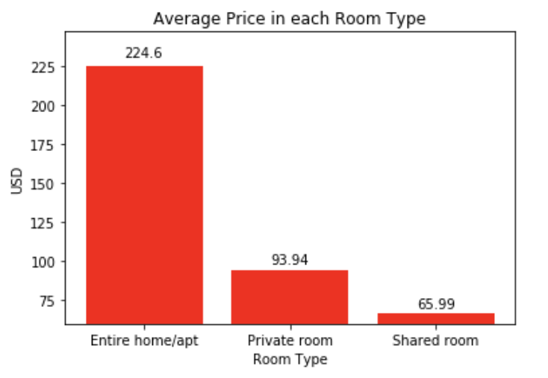
Analysis by Room Type
Average price of a room time when compared for private or shared room we found that shared room is much cheaper.

Slide 21
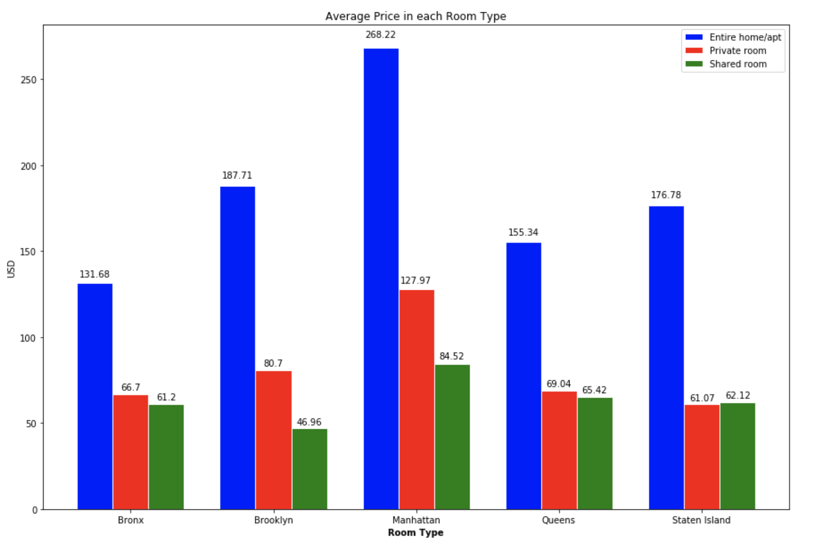
Analysis by Room Type
Multiple bar graphs with the room type and neighbourhood shows the average listing price in each neighbourhood.

Slide 22
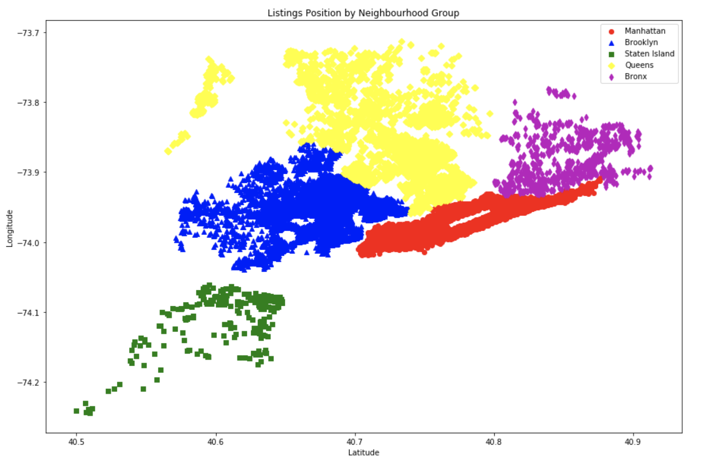
Listing Density in Manhattan
Scatter Plot/ Heat Map of the density in Manhattan:
We found the density of listings visually to be highest in Manhattan when plotted via scatter plot with multiple colours and symbols

Slide 23
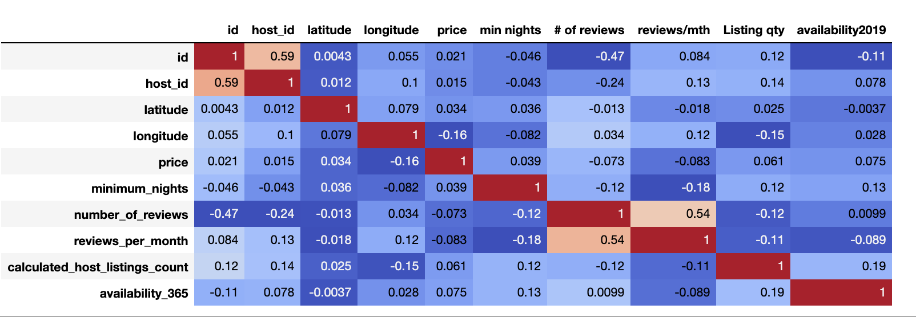
Correlation of all the factors across 2 axes
When plotting the correlation of the factors in the dataset analyzed, we observed the correlation as below:

Slide 24
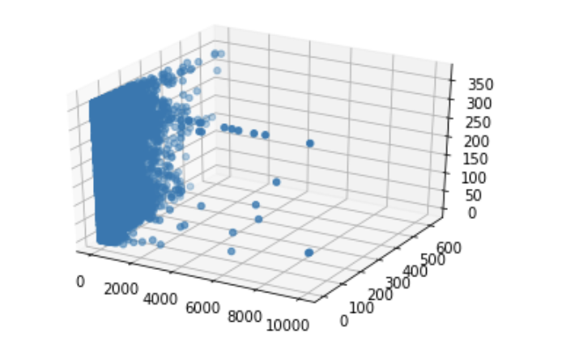
Density of listings in each by price
When we tried a 3D plot of the data set for all the listings to find the clusters and outliers most of the data points tended to lie in close range as shown in the 3D plot.
The need to have more diverse data ste to analyse the outliers or clusters would be beneficial in 3D plotting.

Slide 25
What do our finding mean?
Airbnb affects the city's housing supply and affordability.
The key variables of Airbnb use and how it impacts your neighborhood?
Room Type
It is evident that short term private and shared room listings encourages higher listings due to affordable price compared to entire apartment/home
Some of these rooms are available for entire 365 days of the weeks
Availability
Entire homes or apartments are highly available and rented frequently year-round to renters compared to shared/ private rooms
Even private rooms or sublets have also been homes for both New Yorkers and tourists
Price / Income The minimum stay, price and number of reviews are indicators that Airbnd has an effect in the city’s housing market and affordability.
With Manhattan as an example the price difference for shared/ private room is nearly 50% or less
An average private /shared room listing would range between 65 to 94 dollars

Slide 26

Thank you!

